Slide 1
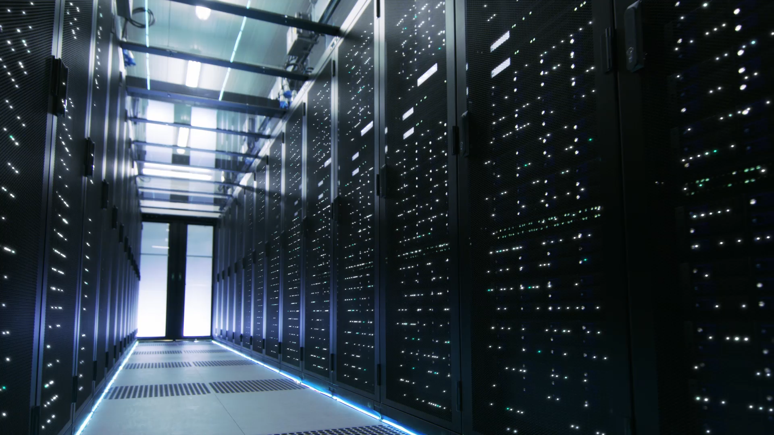
Data Programming
Final Presentation
Group 13

Slide 2
Group Members
Amul Ghodasara
Project Manager & Developer
Amish Dungrani
Developer
Kevin kayoonnapara Siby
Data Analytics

Slide 3
Summary
Demonstrated the acquisition of a data source from a remote source
Stored acquired data in a database
Web application

Slide 4
Step 1
Dataset:- Crypto Currency
Source:- https://api.coindesk.com/v1/bpi/currentprice.json
In 1st step, we select dataset which is based on crypto currency and it if from remote source ( URL ). And our client would be very interested because this is what they are looking for.

Slide 5
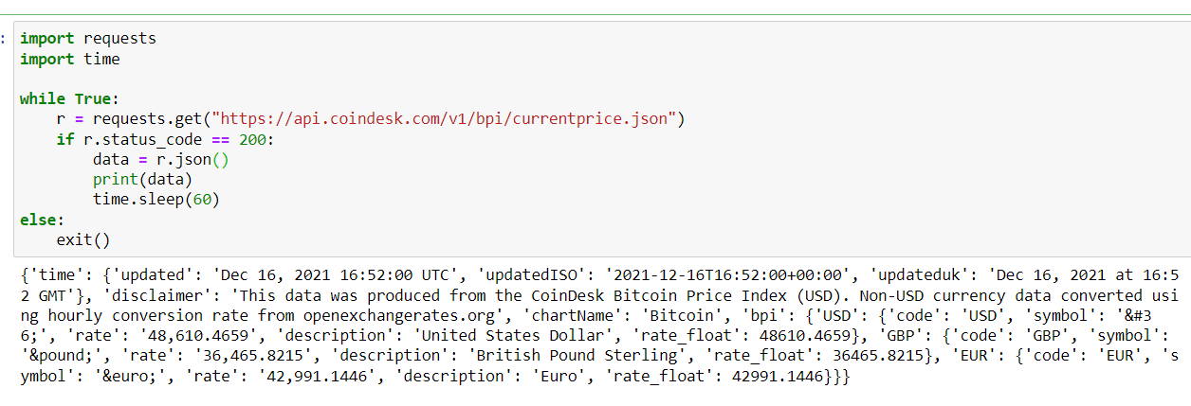

Slide 6
Step 2
Here, we used MongoDB as cloud database because it is free and easy to handle.
With the help of python, we run pseudo-batch process that runs every 24-hours to acquire data and store in that database.

Slide 7
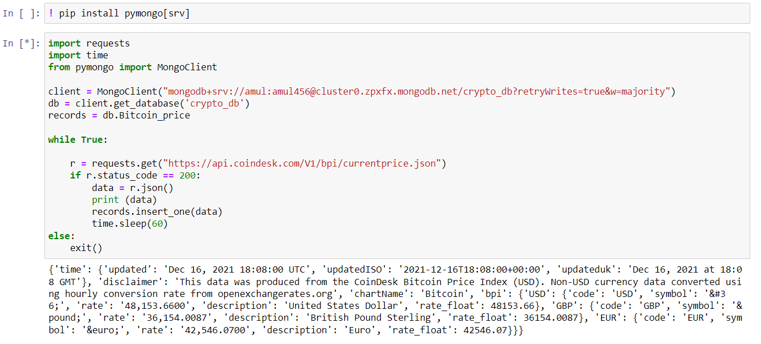

Slide 8
Step 3
Web Application
We developed web application with the help of Flask framework in python.
In our web application, customers can watch all the updates of current crypto markets as well as they can check the latest price of any crypto currency.
We also developed one dashboard in web application, where users can monitor the past price of currency and can easily analyzed it.
URL
http://amul456.pythonanywhere.com/

Slide 9
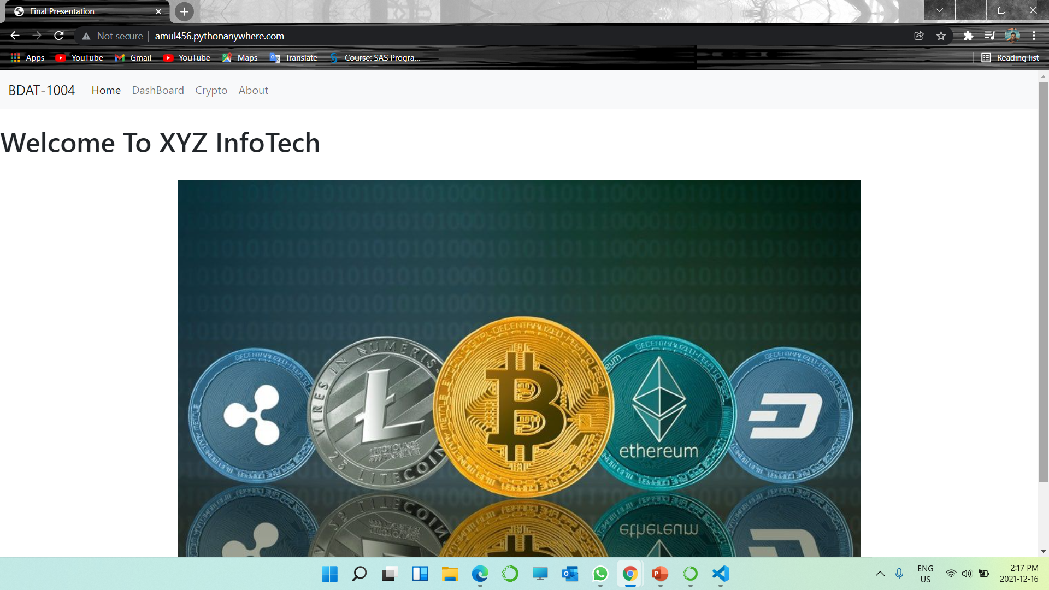
Welcome page
In welcome page, users can find all the brief introduction about our application, latest news from crypto market, log in/sign up page process.

Slide 10
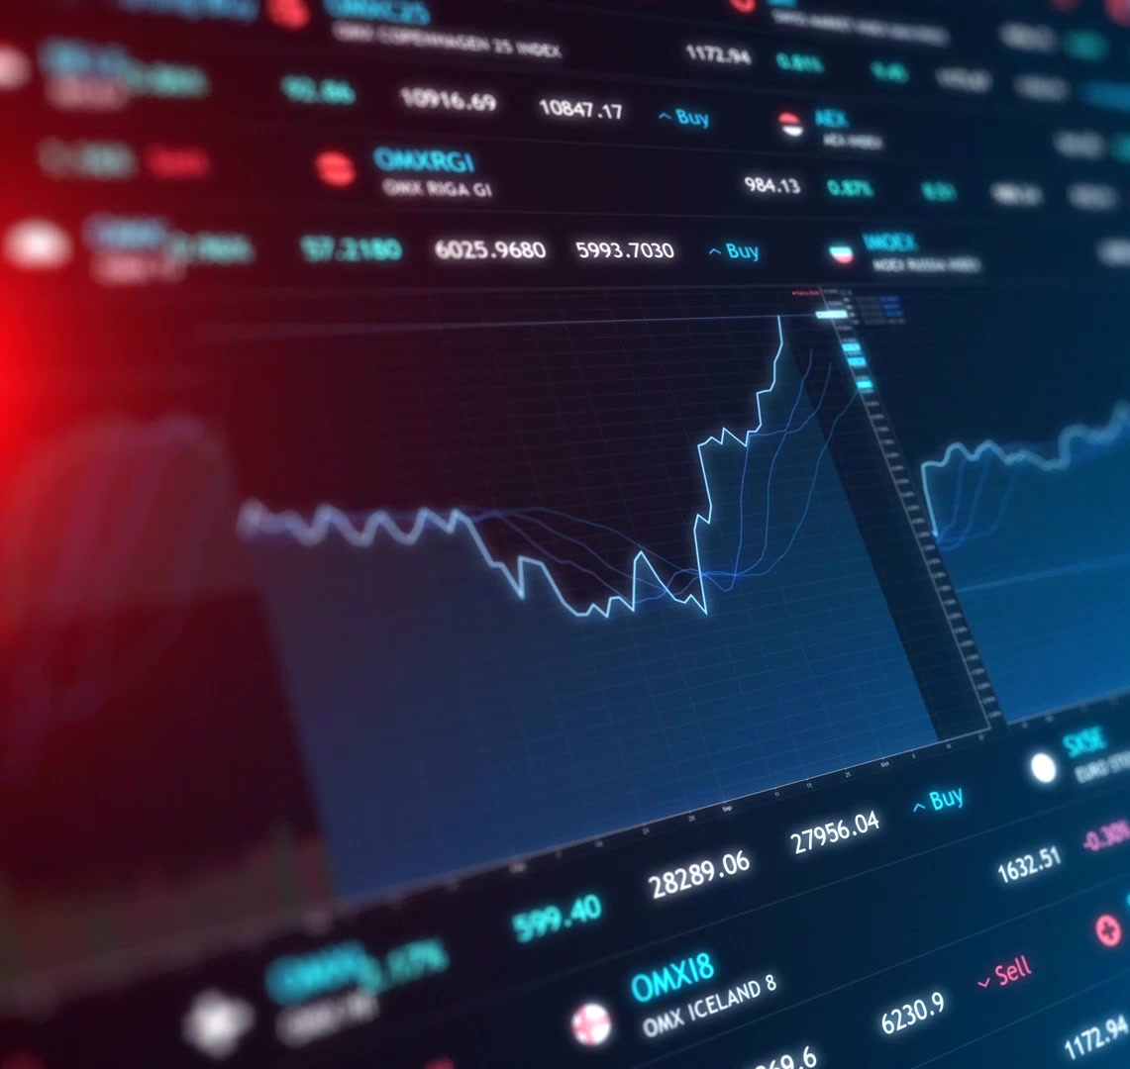
Dashboard
In Dashboard, users can easily monitor the market.
They can analyze different crypto currency in one place.
They can monitor Yesterday’s market, past week, past month report of each currency.

Slide 11
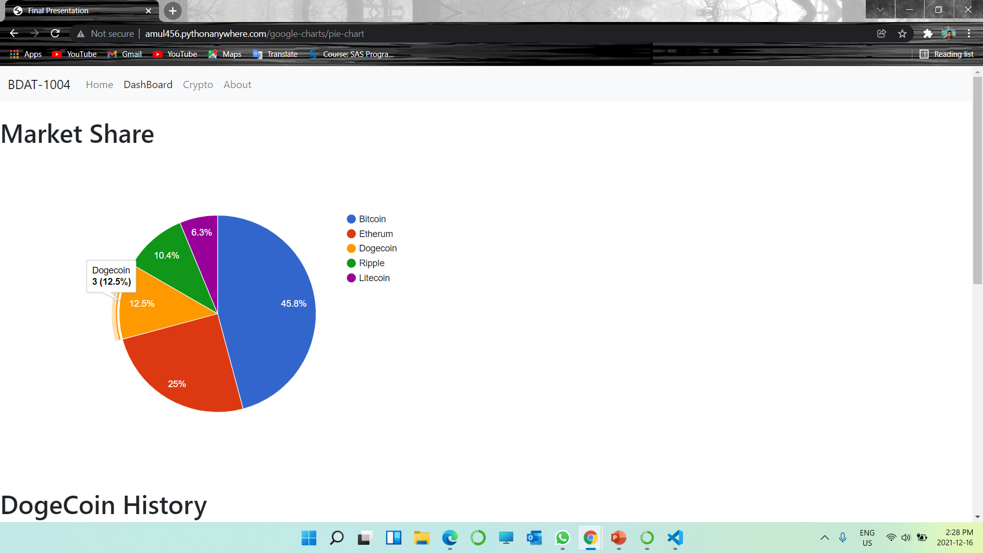

Slide 12
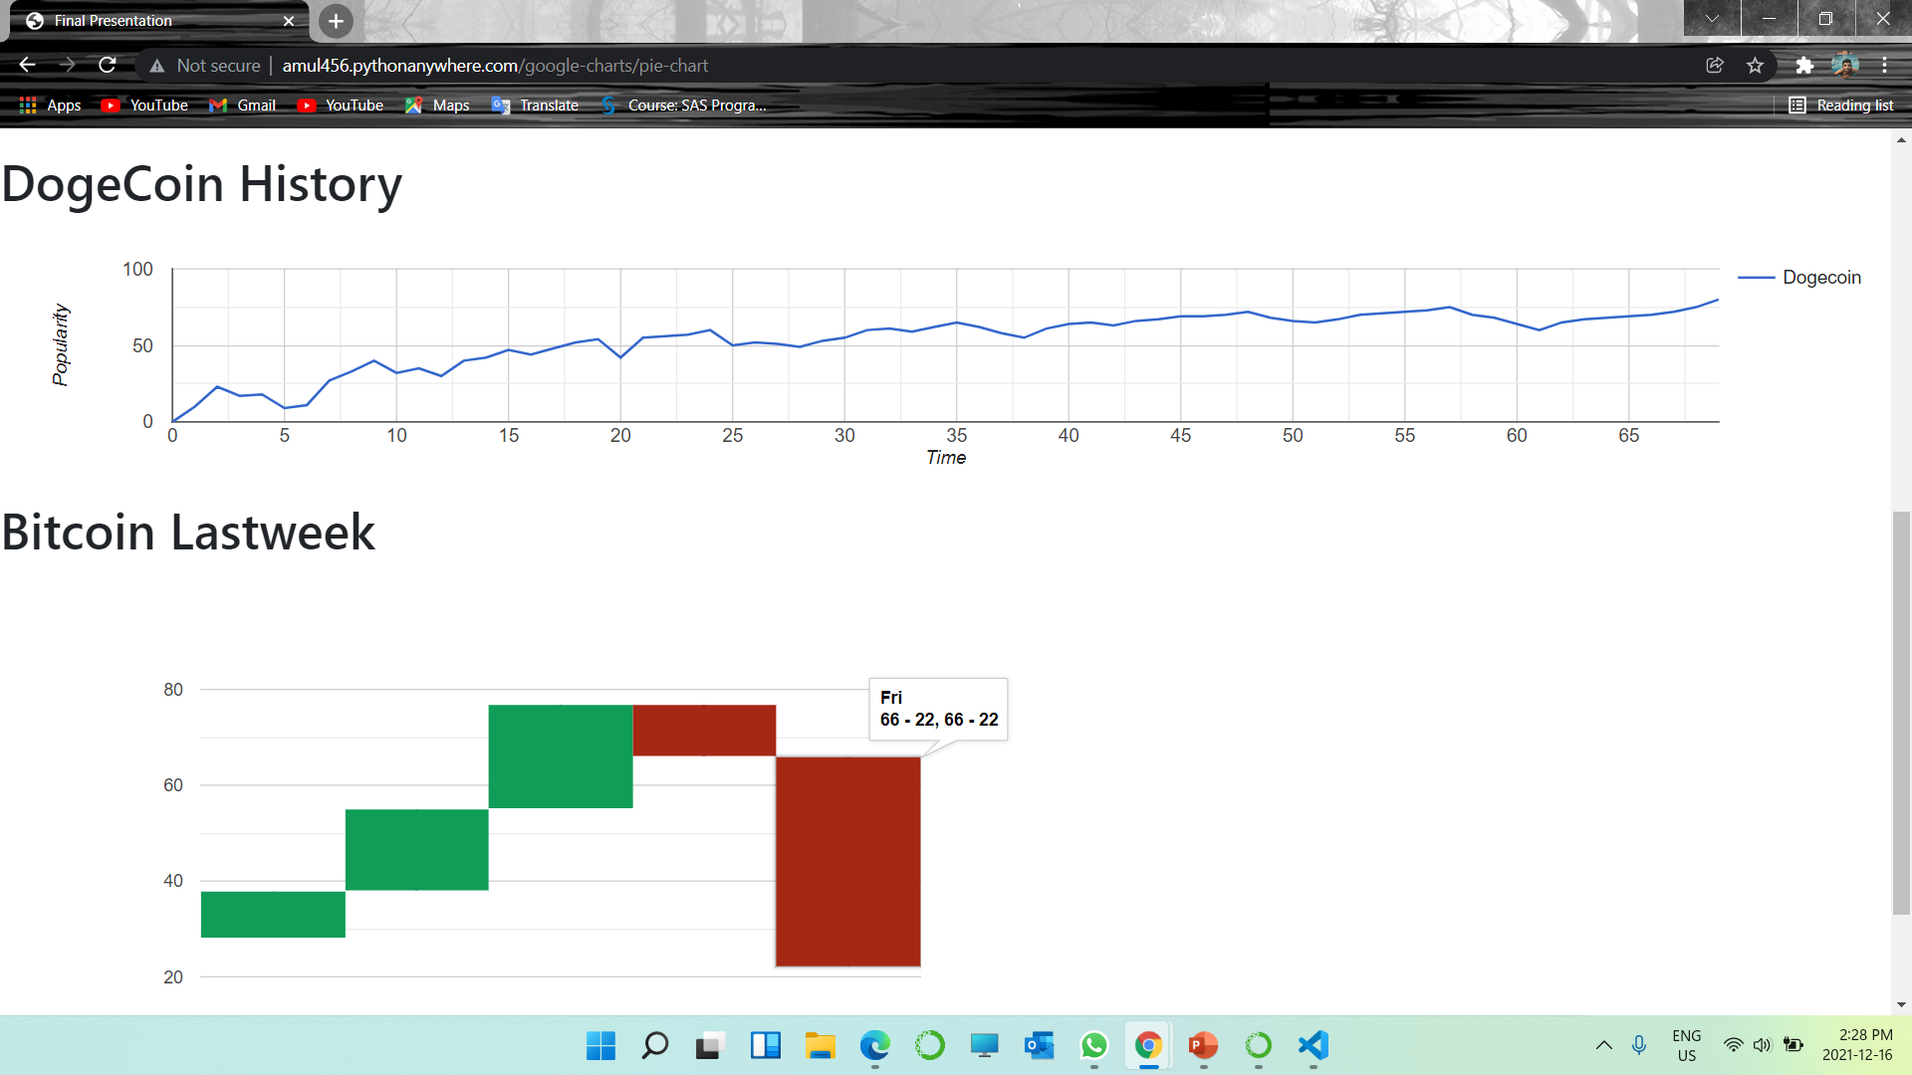

Slide 13
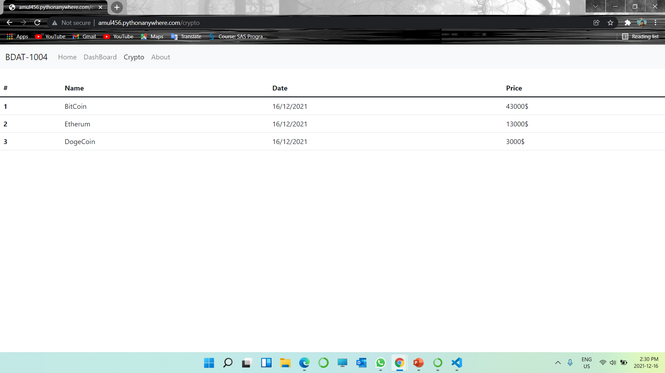
Crypto page
In crypto page, user can watch current price of each crypto currency.
They also get live update of every second of fluctuation in market.
They also get buy and sell option if they have membership.

Slide 14
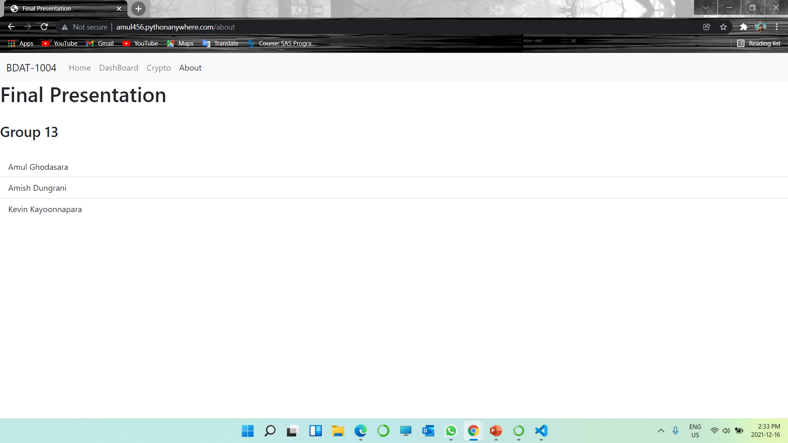
About us
In About us, users can know us very well.
They will get know about our firm, our achievements, our goals, our motivation as well as they can give us feedback if they want.

Slide 15
Source
In developing process, we used referral templates to create our web application.
We used bootstrap, W3Shool, google charts in development of this web application.
We also get reference from lectures video as well.

Slide 16

Thank You

